Slide 1


DATA ANALYTICS WITH TABLEAU

Slide 2
ARASU COLLEGE OF ARTS AND SCIENCE FOR WOMEN, KARUR. WELCOMES YOU ALL

Slide 3
ESTIMATION OF BUSINESS EXPENSES

Slide 4
III.B.Sc PHYSICS
LEADER:
DHANUSHIYA.R
:TEAM MEMBERS
DURKANANDHINI. S
SATHYA. T
FACULTY MENTOR:
Mr. M. RAJALINGAM M.Sc., M.Phil., B.Ed.,

Slide 5
INTRODUCTION
Estimating all the expenses required to start and operate the business, such as equipment, rent, inventory, and marketing.
By calculating these costs upfront, business owners can better plan their budget and avoid unexpected expenses.
Cost Estimation is a statement that gives the value of the cost incurred in the manufacturing of finished goods.
Cost estimation takes into consideration all expenditure involved in the design and manufacturing along with all related services.
If the highest and lowest levels of expenses.

Slide 6
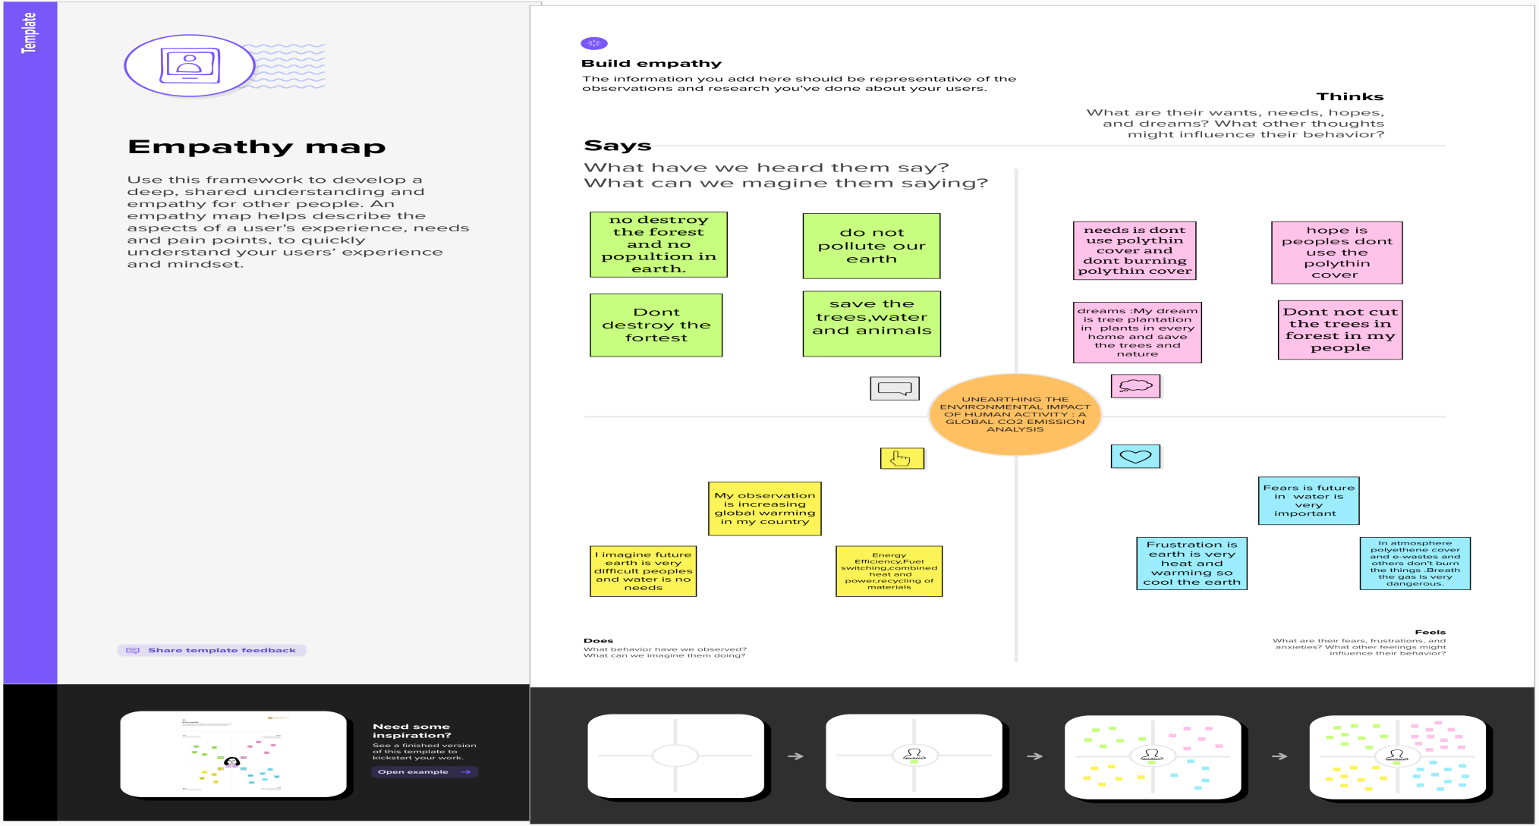
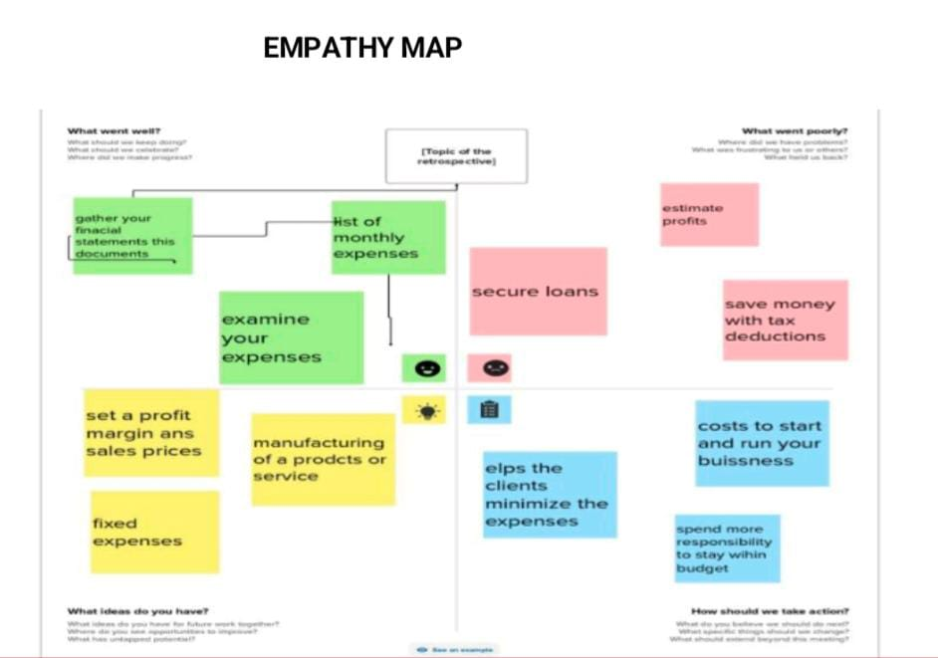
EMPATHY MAP

Slide 7
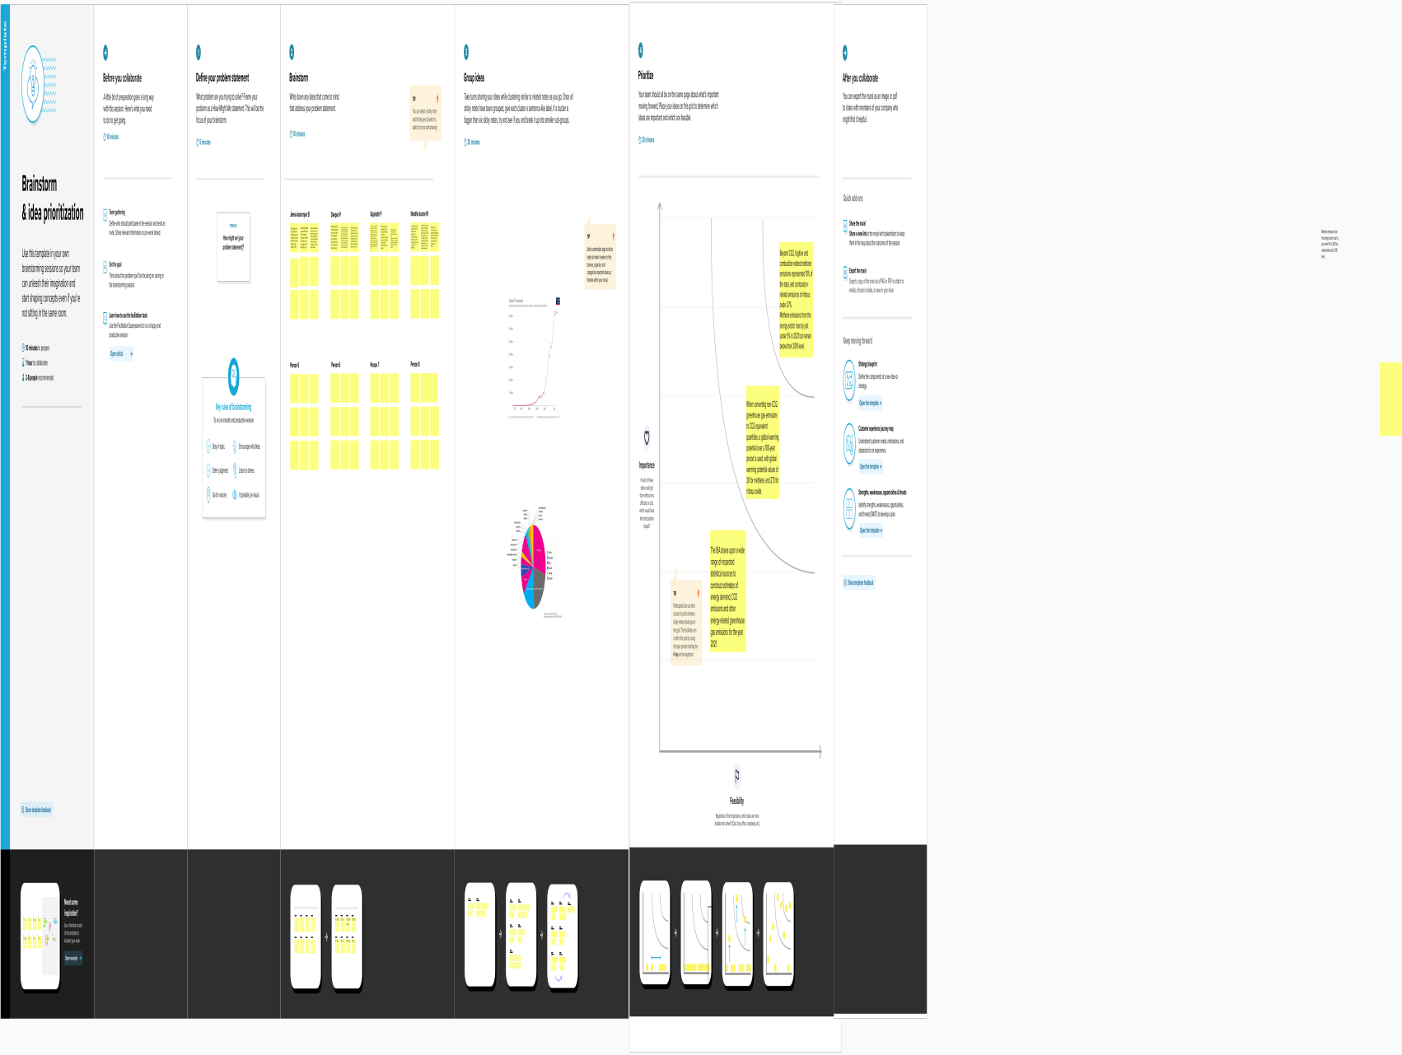
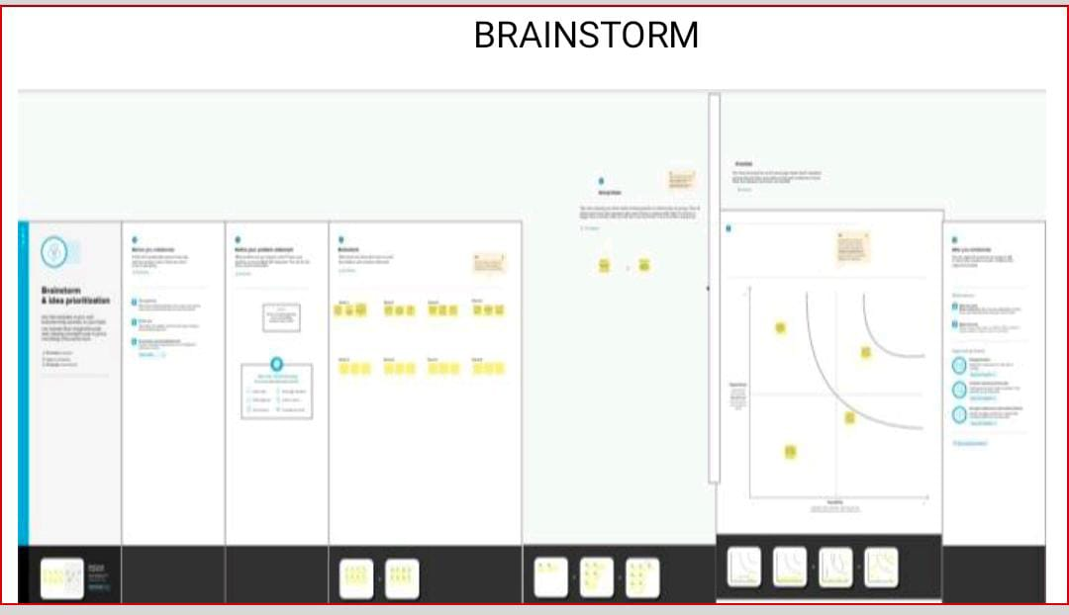
BRAINSTORM

Slide 8
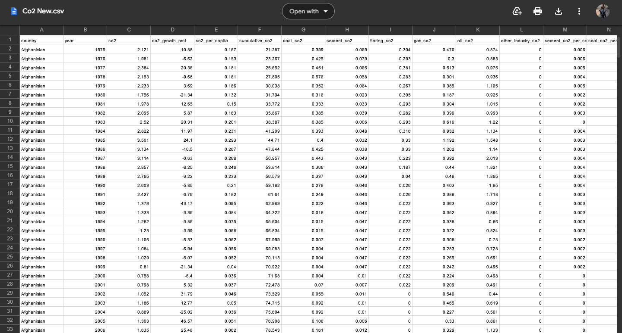
DATA SET

Slide 9
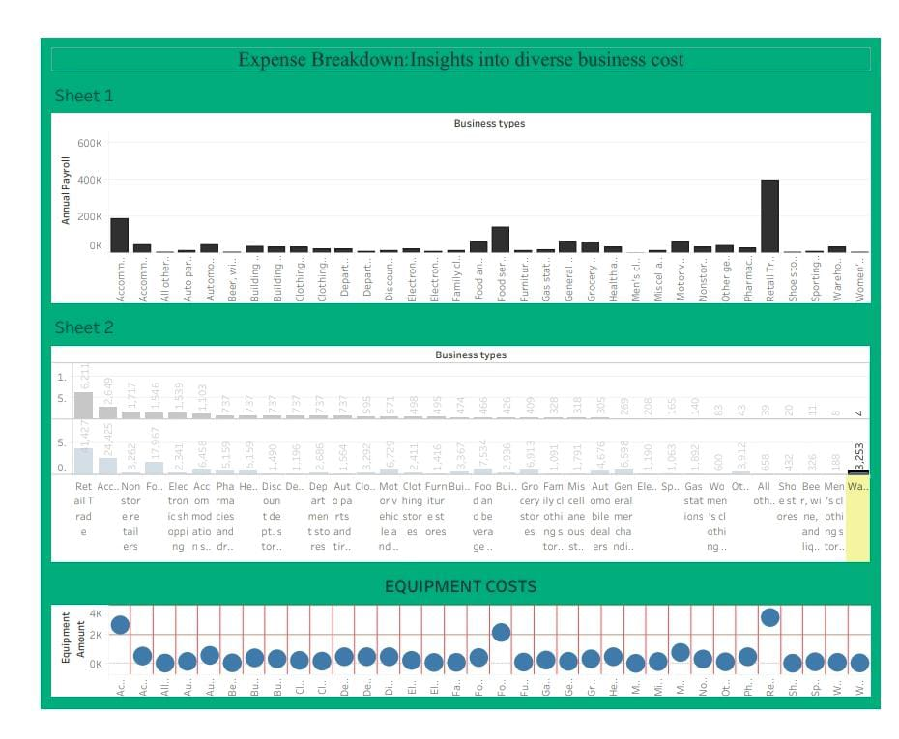
ACTIVITY 01 DASHBOARD 01

Slide 10
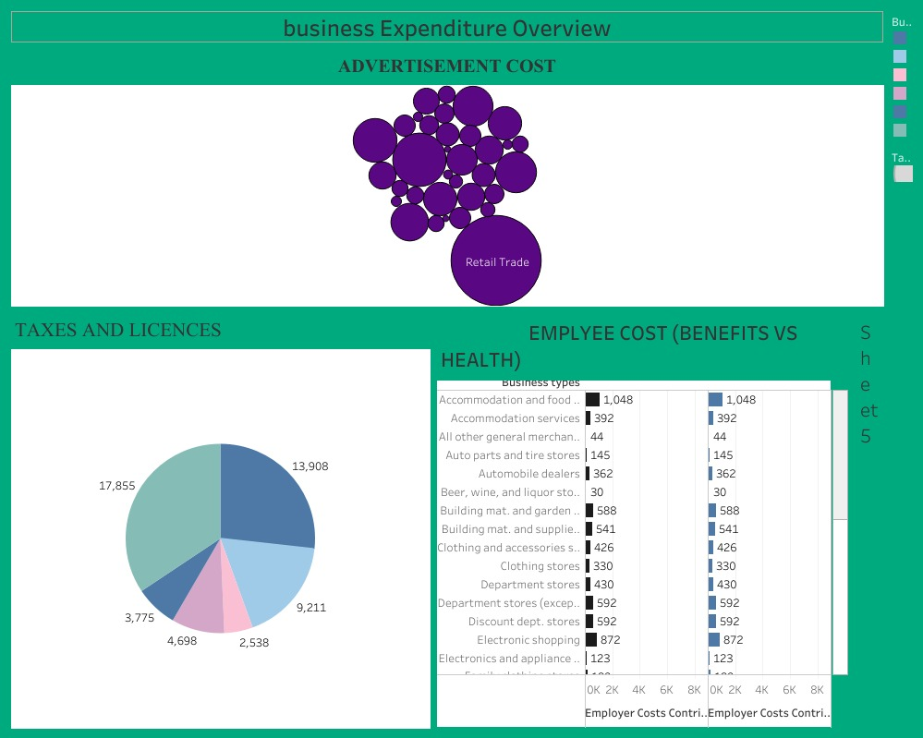
ACTIVITY 02 DASHBOARD 02

Slide 11
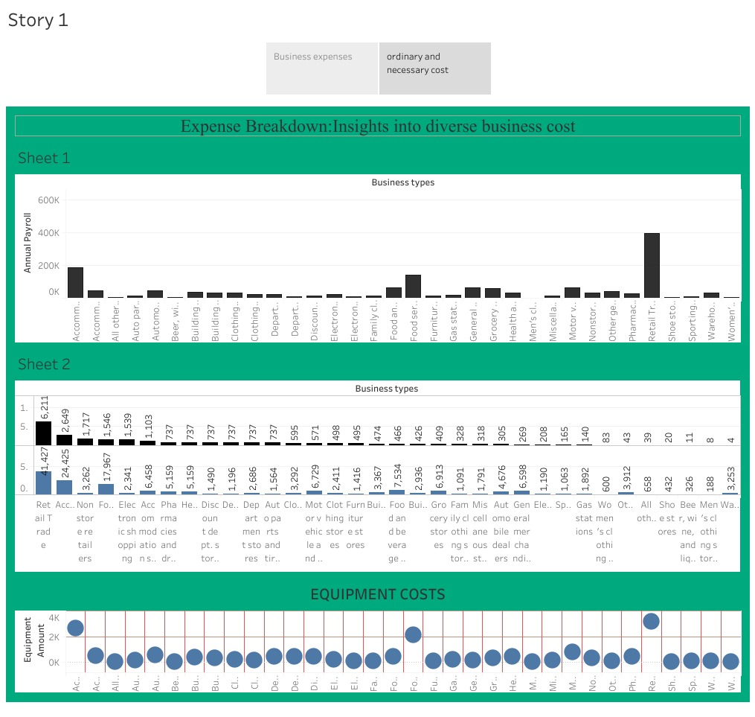
ACTTIVIY 04 STORY 01

Slide 12
WEB INDEX
https://public.tableau.com/app/profile/durka.nandhini.s/viz/Storydurkanandhini/Story1?publish=yes
https://public.tableau.com/app/profile/durka.nandhini.s/viz/dashboard1durkanandhini/Dashboard1?publish=yes
https://public.tableau.com/app/profile/durka.nandhini.s/viz/dashboard2durkanandhini/Dashboard2?publish=yes

Slide 13
Advantages 1. Helps in setting prices
. Enhances productivity
. Identifies unecessary costs involved
. Helps the management make effective decisions.
Disadvantages
Records past data
Expertise required
. Expensive maintenance
. Costs keep changing every interval

Slide 14
CONCLUSION
In business, an estimate is a calculated guess of what something will cost.
Estimates are often used in building for contract or projects.They can also be used to find out how much material or labour is needed for a job
An accurate estimate can mean the difference between winning and losing a contract.

Slide 15


